Slide 1
Academic Review A dive into the effects of different variables on student performance in US Public Schools
Paper Straws. LLC
Notes:
mw

Slide 2

Motivation
NFL → Radiation → Books → Plastic Waste → Education
Background: The team decided on Education due to the numerous and robust datasets available, and less so due to personal interest in the topic.
Reasoning:
Discoursed topic
Relatable topic
Digestible topic
Enrollment in GT bootcamp
David’s kids
Notes:
mw

Slide 3
Core Questions
Is student performance* in the US affected by student:teacher ratio?
Is student performance* in the US affected by teacher salary?
Is student performance* in the US affected by school financials?
Is student performance* in the US affected by per student spending?
Are there other factors that would contribute to our findings?
*”Student performance” defined as High School graduation rate
Notes:
scott

Slide 4
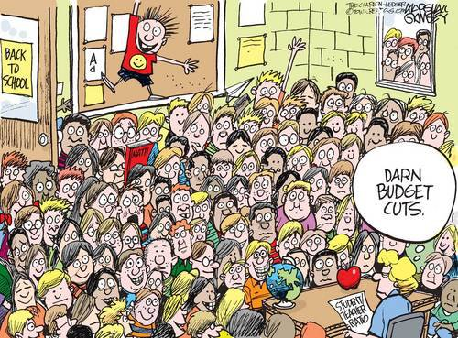
Discovery and Analysis
Notes:
scott

Slide 5

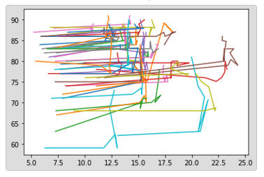



Our Process
Notes:
Sean

Slide 6

Discovery and Data Sources
Google
Kaggle
US Department of Education
US Department of Labor
National Center for Education Statistics (NCES)
National Education Association (NEA)
Census
Our Brains!
Notes:
Sean

Slide 7
Data Cleanup
Deep dive into datafiles
Identify outliers and issues from visualizations
Cleanup directly in excel file as well as Jupyter notebooks
Oklahoma
Alabama
etc
Re-defined parameters
Re-established metrics
Notes:
Scott

Slide 8
Data Analysis
Review datasets
Discuss strategy
Brainstorm visualizations
Manipulate data real-time
Determine charts and chart types for presentation
Identify data for statistical analysis requirement
Analyze data and visualizations, uncover findings
Notes:
Scott

Slide 9
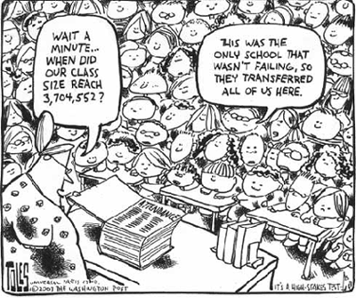
Findings
Notes:
Saurin

Slide 10
Key Findings
A correlation between improved graduation rates and increases in various spends was observed
Between 2011-2013, graduation rate in the US was flat (80%):
2013-2014 saw an increase of 4%
2014-2016 increased 2%
Although student-teacher ratio has been flat over the years (15.5), there is an inverse negative relationship between student:teacher ratio and graduation rate
An increase in teacher salary across the US is correlated with higher graduation rates
2011-2013 increase: 2%; 2014-2016 increase: 4%
Notes:
saurin

Slide 11
Key Findings
An increase in allocated revenues is correlated with higher graduation rates
2011-2013 increase: 0%; 2014-2015 increase: 8%
An increase in per student spending is correlated with higher graduation rates
2011-2013 increase: 2%; 2014-2016 increase: 5%
A change in requirements for graduation, along with efforts such as “No child left behind” should also be considered as factors when looking at improved graduation rates
Notes:
Saurin

Slide 12
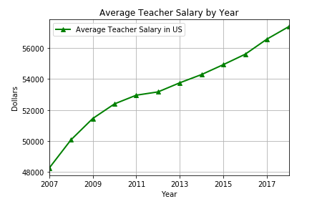
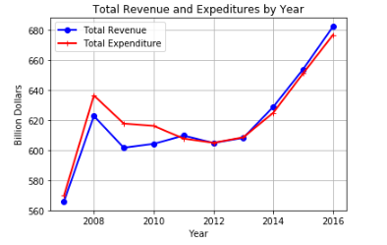
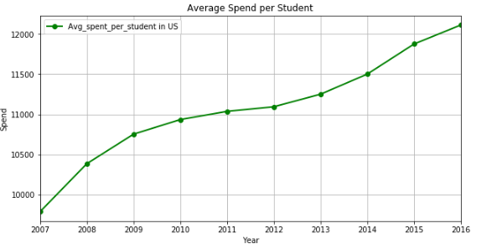
Aggregate Findings – US Trends
As of 2013, teacher salaries increased at a higher rate than recent previous years. Expenditures and avg spend per student also increased during this timeframe
In addition, a change in educational standards was implemented in 2013, which was that there was a shift from focusing only on standardized tests, to include a focus on life and educational skillsets
Increased focus on higher graduation rates overall in US in recent years; such as “No child left behind” initiatives
For the Class of 2015, which had a graduation rate of 82.43 percent, a 90 percent graduation rate would have meant an additional 250,000 students would have walked across the Commencement Day stage.These graduates would collectively have earned $3.1 billion ANNUALLY in additional income.That additional income isn’t going under the mattress. It’s being spent in local grocery stores, restaurants, and other businesses, powering national, state, and local economies. And these new graduates are also contributing more in the form of tax dollars—roughly $664 million collectively by the midpoint of their careers. That tax revenue will go toward public schools, roads, and a variety of other public goods. In total, the collective spending power of these new graduates will lead to greater opportunities for the nation, including $5.7 billion in economic growth and more than 14,000 new jobs created. And because high school graduates tend to live more healthy lives than high school dropouts—and because they are more inclined to obtain and have their own health insurance throughout the course of their lives, these new graduates will save the nation $16.1 billion in health care costs.
2:53
done son
2:55
And then we can co-relate to the economy. Ofcourse they are million other factors for economy to grow but education is one of the big one
melissa 2:57 PM
oh yea that's good info
Saurin Patel 2:57 PM
And i don't think anyone will que
Notes:
Saurin

Slide 13
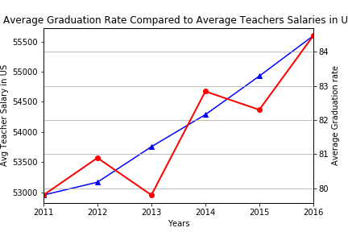
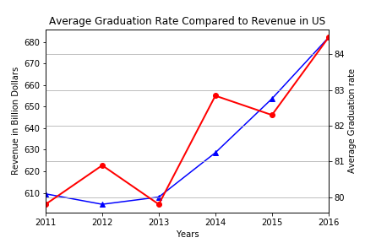
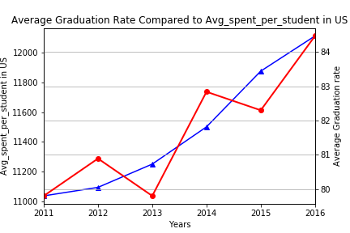
Aggregate Findings – US Trends
Correlated with increase in various spends in the previous slide is an increase in graduation rates in recent years
Higher graduation rates result in:
Additional personal income
Additional tax dollars generated, which help fuel economic, and therefore Educational growth
General overall economic growth: lower healthcare costs, revenue back into state and local communities, generating new jobs
Source: https://all4ed.org/high-school-graduation-rates-and-their-effect-on-the-american-economy/
Notes:
Saurin

Slide 14
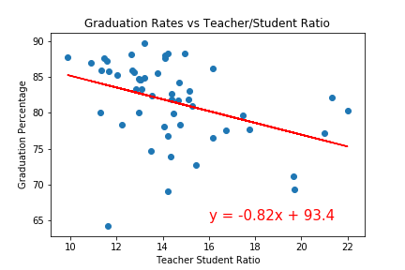
Granular Finding - States Regress
R-value: -3.856
Research has shown that:
Smaller classes, especially in a child’s younger years, leads to better academic performance
Minority and low-income students perform better when placed in smaller class size
The more years a student spends in reduced class sizes, the longer improved performance continues
Classes at 20 or above tend to fail in attempts at reduced class sizing
Source: https://www.ces-schools.net/important-student-teacher-ratio-students/
Notes:
sean

Slide 15
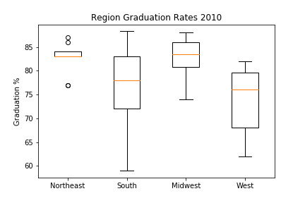
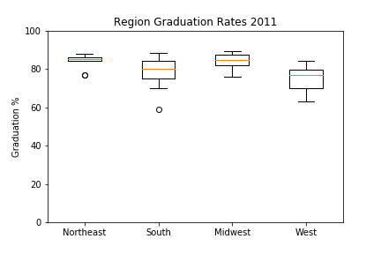
Regional Findings – Statistical Testing
The Northeast has the smallest spread in graduation rate of all the Regions studied
Notes:
scott

Slide 16
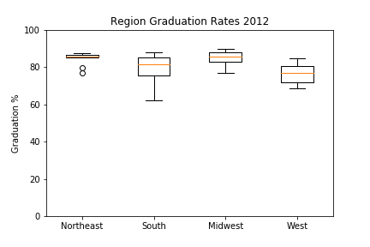

Regional Findings – Statistical Testing
2013-2016, both the Northeast and the South contain outliers
2010 and 2012 Southern Region graduation rates reflect a larger spread
Notes:
scott

Slide 17
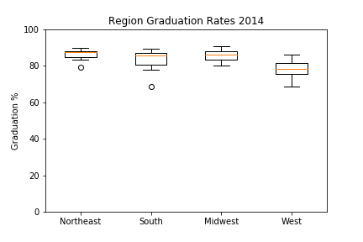
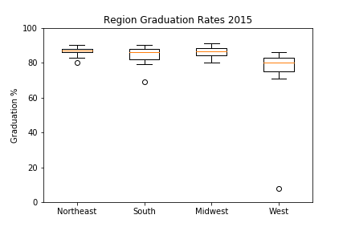
Regional Findings – Statistical Testing
Notes:
scott

Slide 18
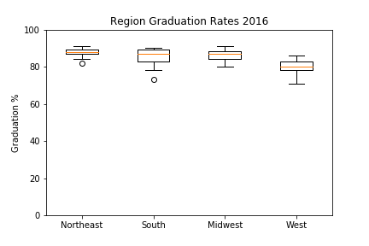
Regional Findings – Statistical Testing
Results show that X region has a y difference – reference mean if applicable, basically stating here what you saw that made you do the anova/t test
Notes:
scott

Slide 19
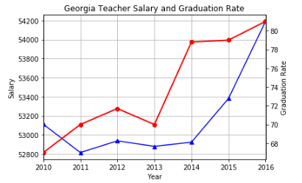
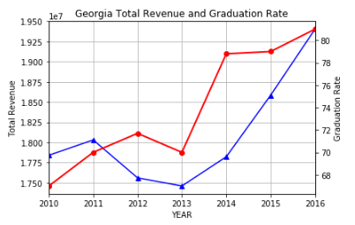
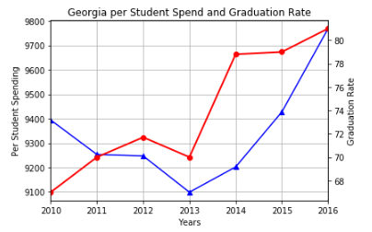
Micro Findings – Georgia
As with overall US trends, we see a shift in graduation rate as of 2013
Graduation rate (red trendline) does not seem to be as closely correlated with the factors studied until 2016; 2016 is more aligned when it comes to revenue and graduation rate in GA; which may be due to a lag effect
The jump in graduation rate in GA seems to be more related to the change in parameters for graduation than financials in 2014 and 2015
Georgia financials are lower than the US average:
Teacher salary: -3% vs US
Per student spend: -20% vs US
Notes:
mw

Slide 20

Implications
Notes:
scott

Slide 21
Implications
Our team found that increases in spends is correlated to higher graduation rates. We believe this implies that if the US spent more on Education (8%), graduation rates would only improve further.
For discussion: Do you agree or disagree? Why?
For discussion: Was the US increase in recent years in teacher salary and other spends surprising to you? Why or why not?
Our team found that the GA graduation rate in recent years is about 4% lower than the national average. The lower graduation rate combined with the fact that GA pays its teachers less, and spends less per student than national average means to us that if GA as a state invested more in Education, the graduation rate would improve.
For discussion: Do you agree or disagree? Why?
Although not specifically revealed in the presentation, most of the top five states in terms of spending have among the worst graduation rates. Our team believes it’s at least partly due to those states playing “catch-up” and that they have not quite met the curve yet. It may also be partly due to the quality of teachers, as well as possibly a higher teacher:student ratio than average.
For discussion: Do you agree or disagree? Why?
Notes:
Sean/saurin

Slide 22
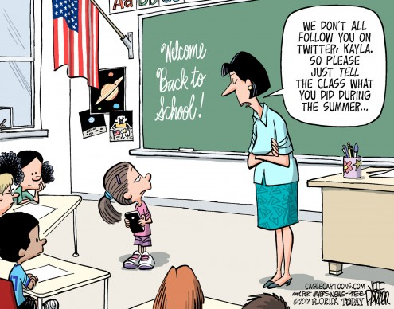
Appendix
Notes:
mw

Slide 23
US Public Schools Overview
~57m students attended elementary, middle, and high schools across the US in 2019
Highest enrollment ever reported for public schools
3.7m teachers 2019
Average salary $59k
US gov’t allocates 8% to public schools ($706B)
Best graduation rate:
Missouri 88%
Worst graduation rate:
DC 69%
Source: https://nces.ed.gov/
Notes:
mw

Slide 24
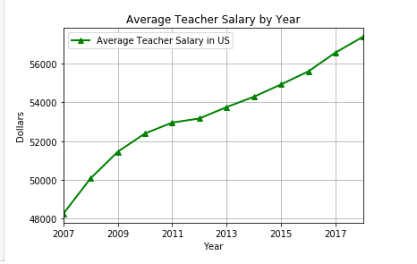
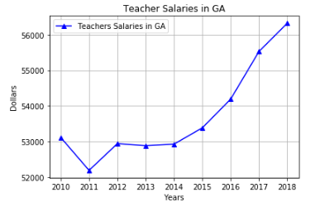
US v GA Average Teacher Salary

Slide 25
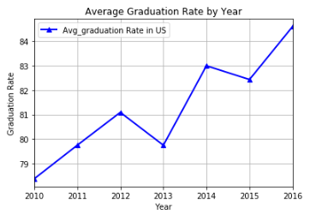
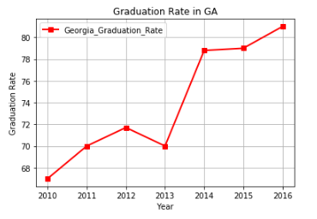
US v GA Graduation Rates

Slide 26
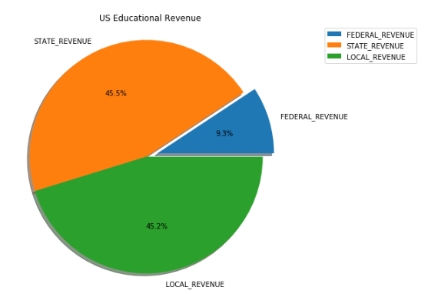
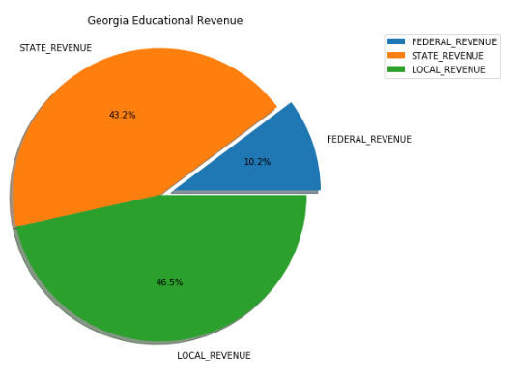
US v GA Educational Revenue

Slide 27
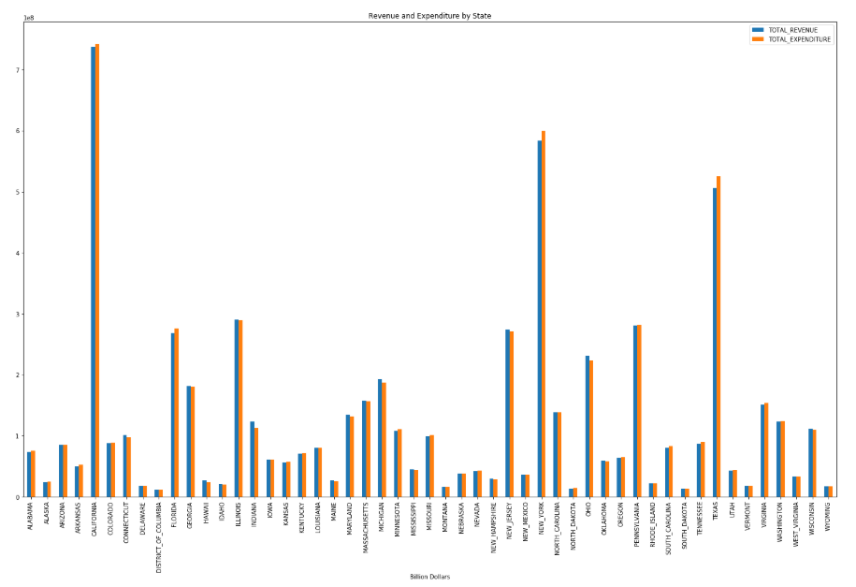

Slide 28
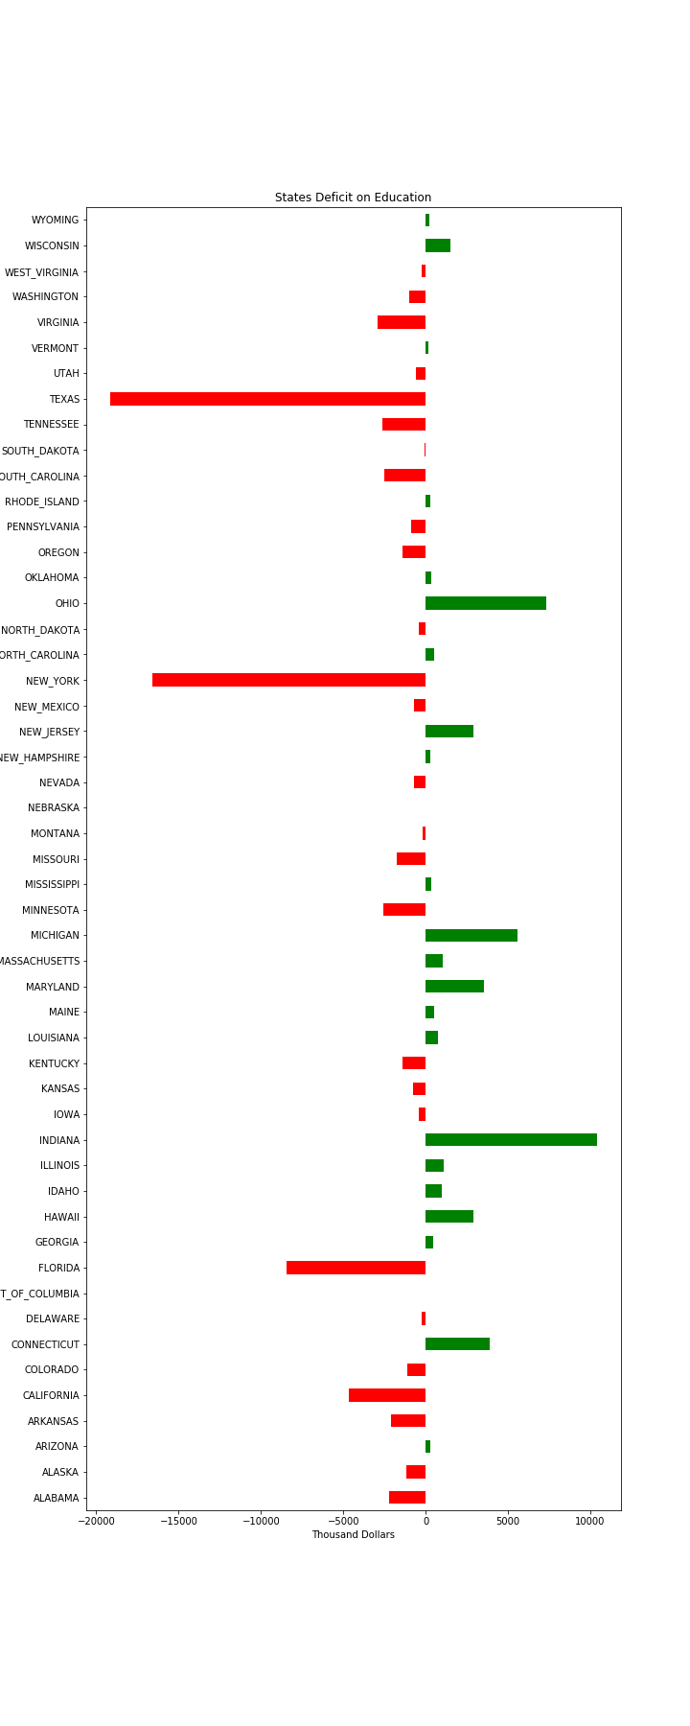
Texas, NY and FL all have the greatest deficits in spend v allocation (these states spend more than they are granted)

